Slide 1
WeFinancesy
Financial Inclusion for You. Everyone. Every Woman & Non-Binary.

Slide 2

Women & Non-Binary are excluded from yet another conversation.
“It must be me. I'm just not smart enough to understand how to invest.” - Simran Kaur
Co- founder of GirlsThatInvest
/ We don't know how to handle our finances
/ We don't know where to discover the relevant information
/ We don't drive any financial revolutions in our lives
/ The reason why every woman & non-binary should have control of their financial assets is to have the freedom to shape their own lives and have the possibility to get out of any situation where a financial dependency makes them captive in e.g., an abusive relationship.
/ Moreover, FIRE allows you to grow money out of your 9-5 job, achieve your financial goals and aim to retire early.

Slide 3
WeFinancesy
Offers a simple education platform for financial inclusivity, removing stigma and having starter knowledge for investment.

Slide 4

A LACK OF CONFIDENCE RATHER THAN A LACK OF MONEY IS A MAJOR REASON WOMEN & NON-BINARY DON'T INVEST.

Slide 5
How does it fit into the theme?
Catering to women & non-binary to give the POWER to make EDUCATED DECISIONS with their money and gain FINANCIAL FREEDOM.
It's SUSTAINABLE and FINANCIAL, we are trying to better equip women & non-binary to make INFORMED financial decisions with Blackrock; focusing on asset management. So when women & non-binary use Blackrock services to build their portfolio they understand the risks and how their money will grow based on their decisions.
This levels the playing field between genders when it comes to the growth of their financial freedom. They are more likely to be confident in achieving Financial Independence Retire Early [FIRE] when understanding the stock market. This creates equality.

Slide 6
What is a Stock Market?
Let's talk about what a STOCK EXCHANGE is first.
A stock exchange is the location like the New York Stock exchange [NYSE] or London Stock Exchange [LSE] where the shares that you invest in can be bought or sold.
It is like a list of companies that you can buy in. The list highlights the change in prices in stock for the company with the comparison to the previous day.
There are approximately 60 exchanges globally. All the exchanges make up the STOCK MARKET.
Here are some types of investment:
> Stocks
> Bonds
> Index Funds
> ETFs
> Commodities
> Alternative investments such as NFTs

Slide 7
WeFinancesy
/ Empowering women & non-binary of any age to have knowledge in financial investment to expose them to financial inclusivity
/ Contributing to closing the gender gap in finance and providing the ability to shape their own future
/ Supporting women & non-binary in any financial situation to explore their options in their journey.

Slide 8
The App
Key Features & Future Roadmap
/ Providing a centralised education platform about financial investment (stock market, ETFs, commodities, asset allocation & management)
/ A widely accessible, free education platform - Android and iOS compatible
/ Harnessing richness of the user community to foster a society of women & non-binary with shared experiences
/ Collaborating with financial institutions and interactive process that involves setting goals, tracking progress, hitting milestones to unlock rewards, which may range from cash incentives to new features for a digital avatar, points to use for discounts, badges, etc – model to motivate women & non-binary.
/ We are NOT FINANCIAL ADVISORS.

Slide 9
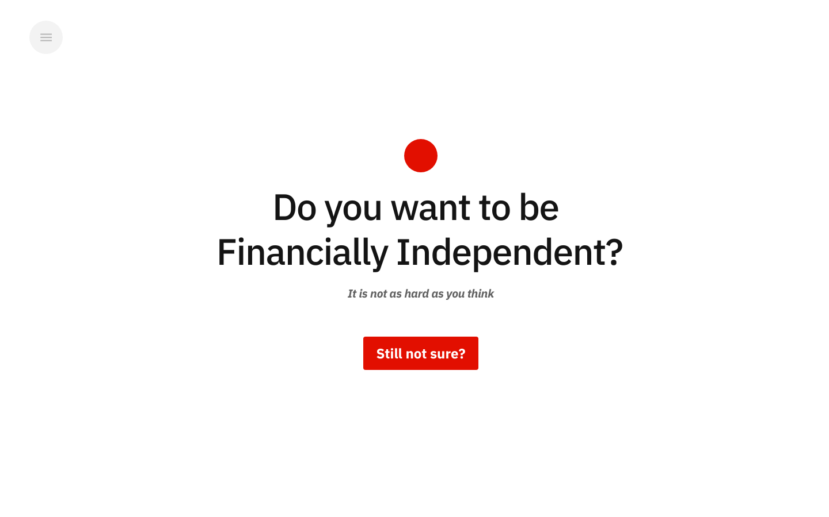

Slide 10
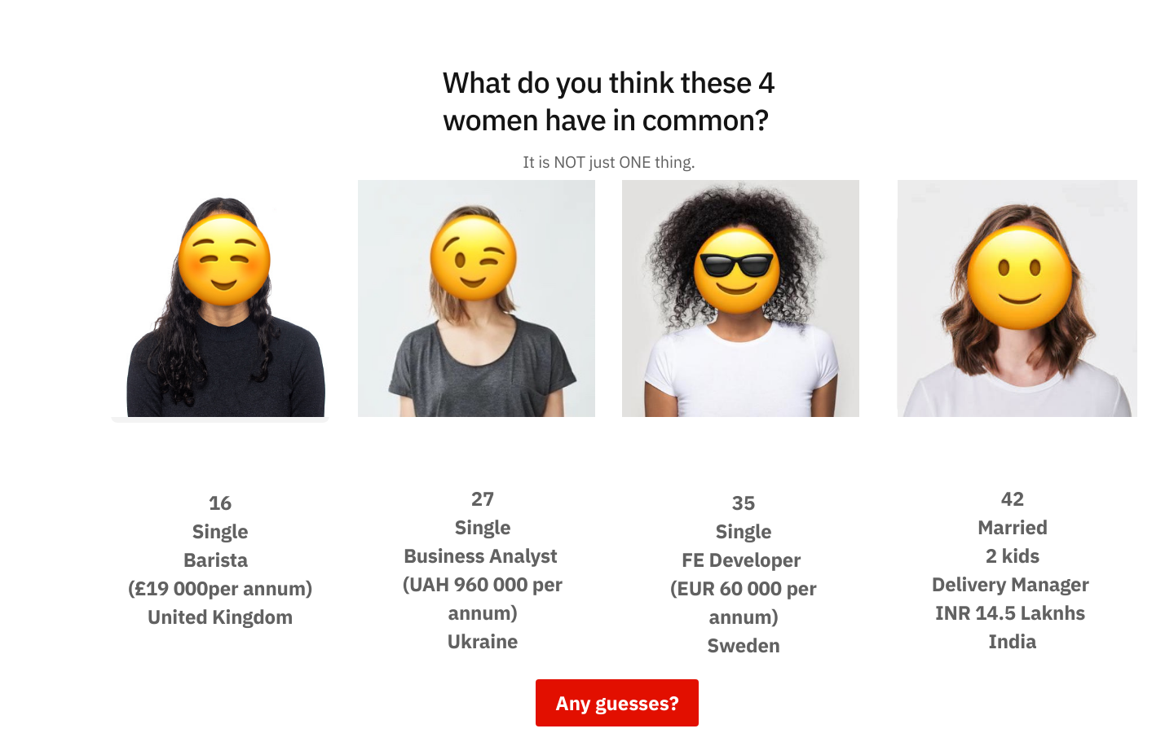

Slide 11
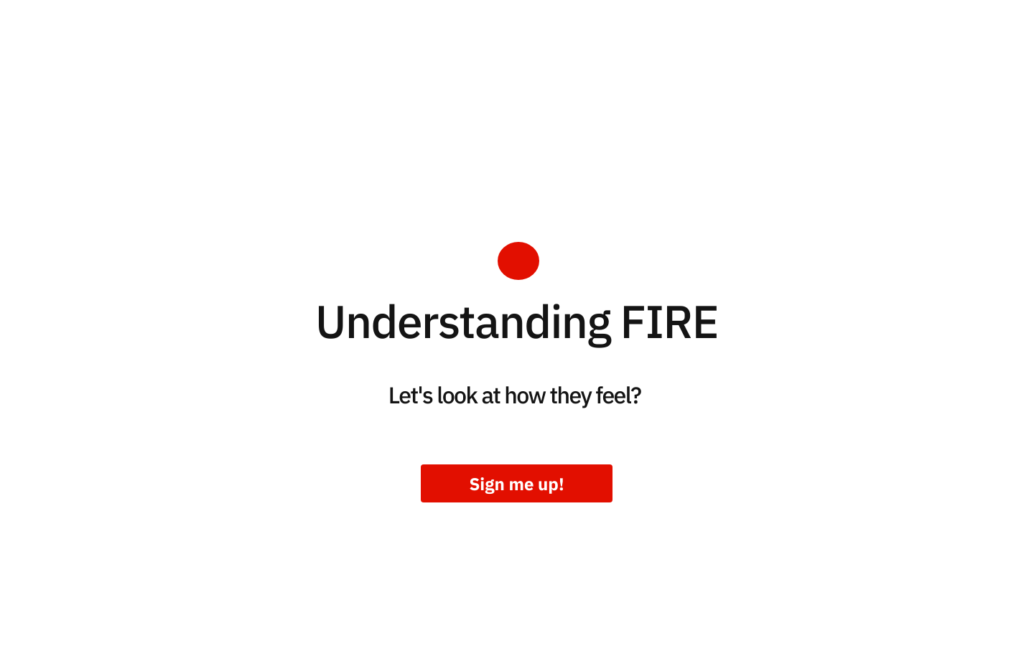

Slide 12
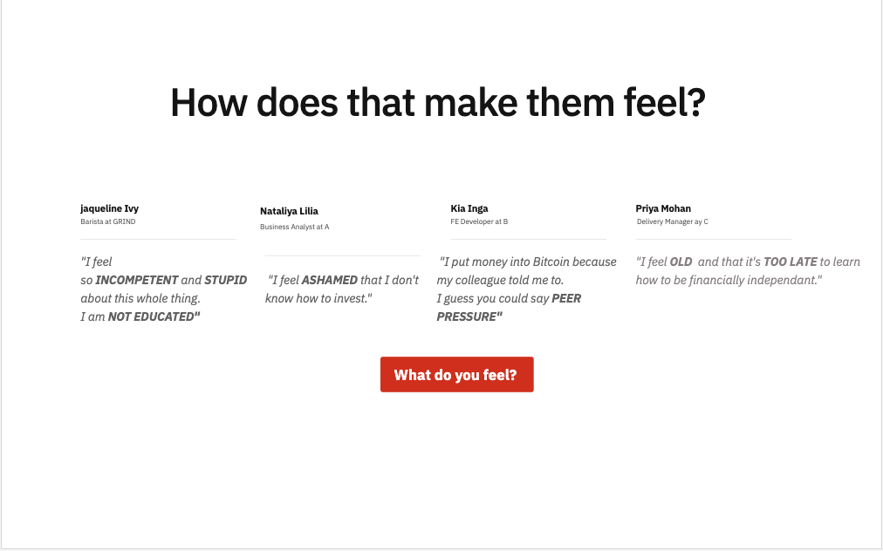

Slide 13
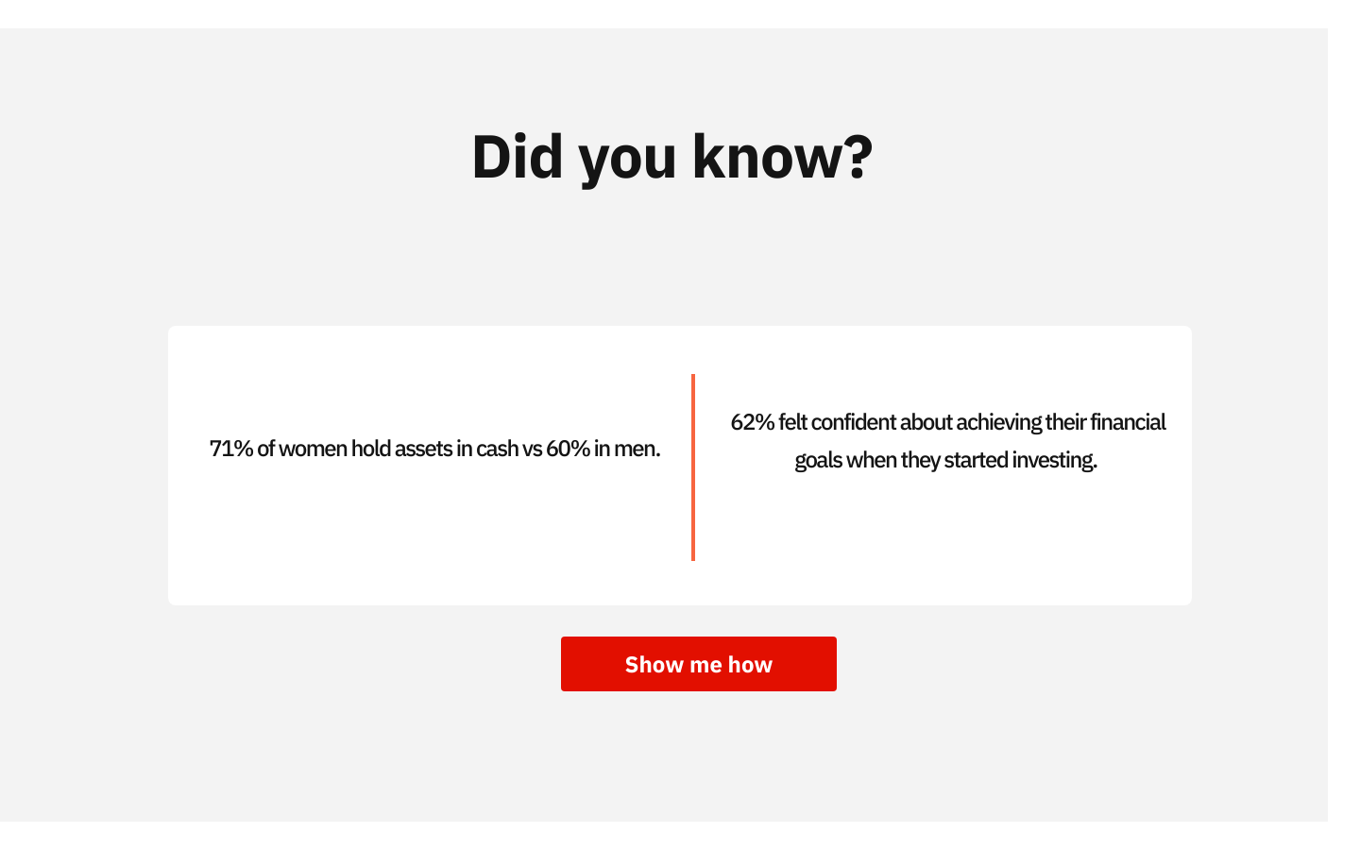

Slide 14
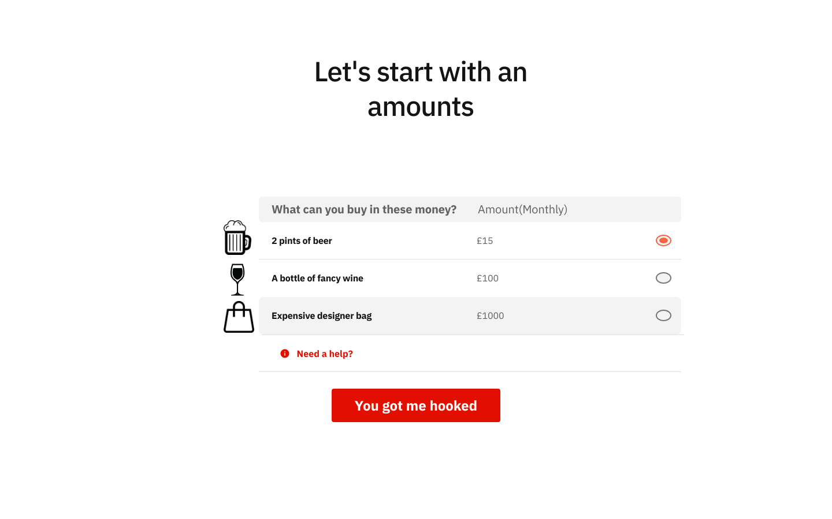

Slide 15
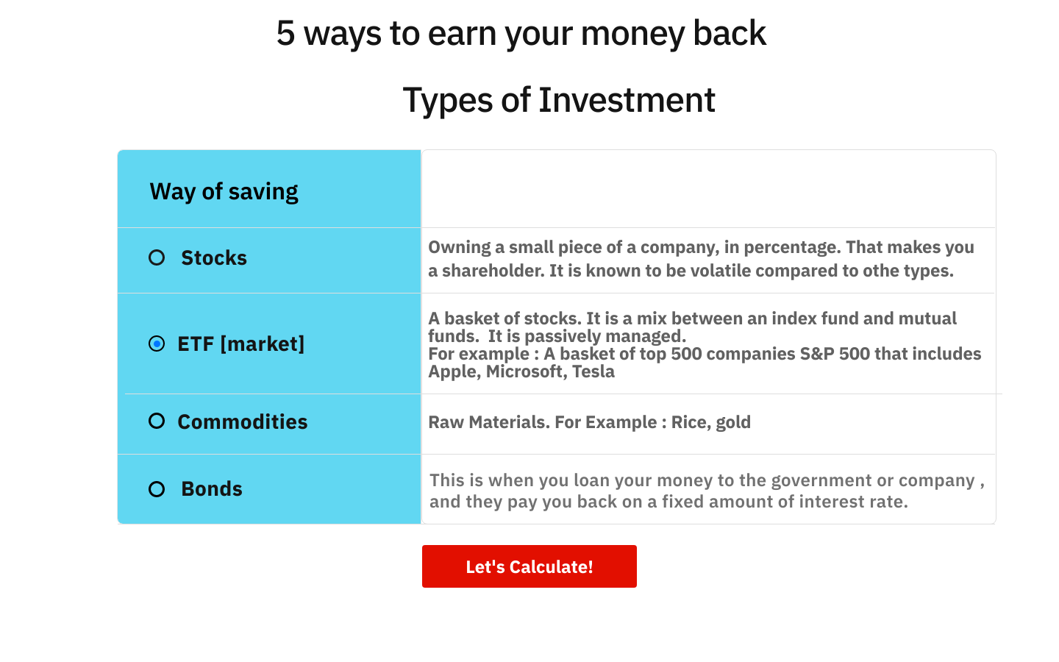

Slide 16
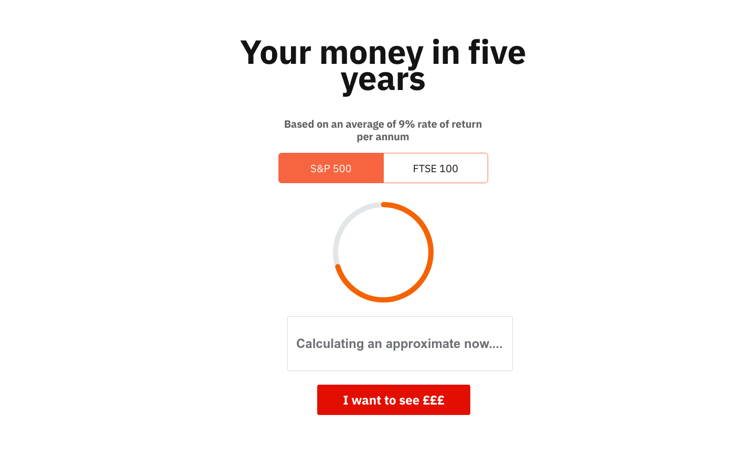

Slide 17
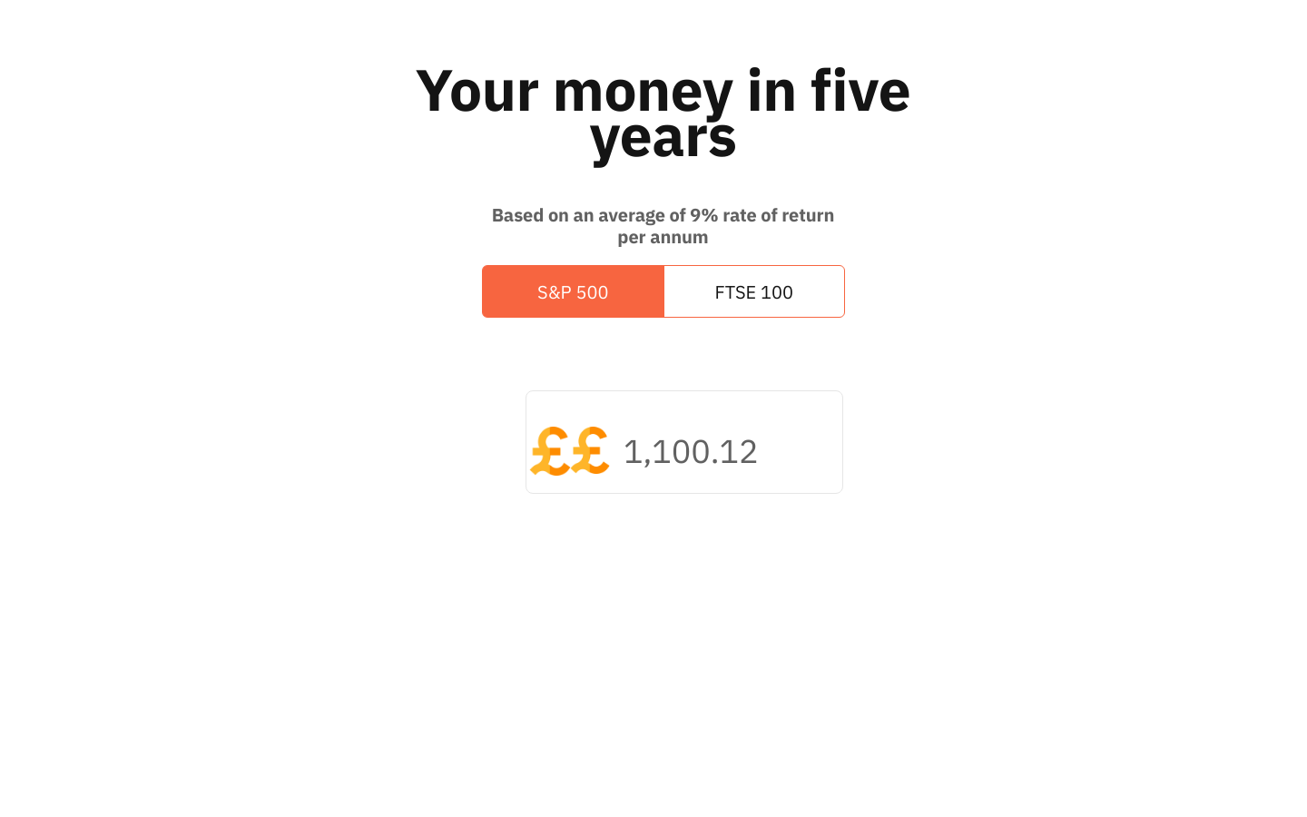

Slide 18
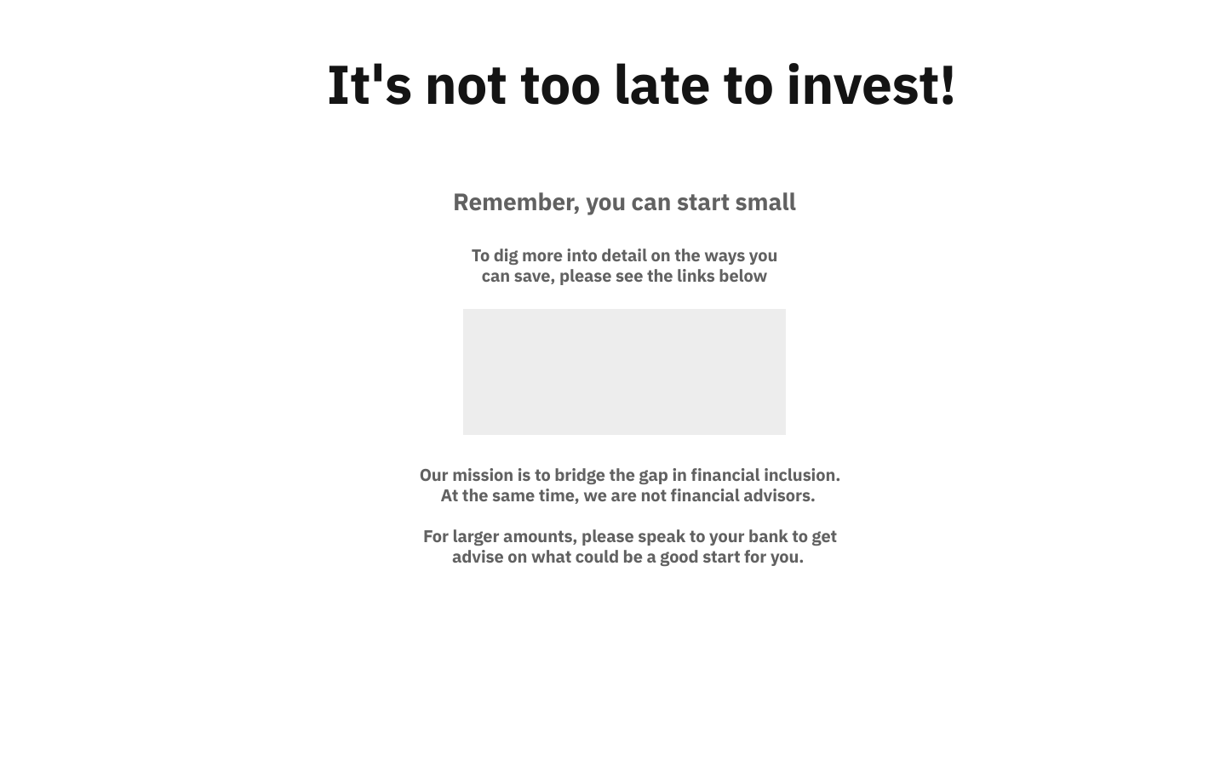

Slide 19

Thank You!
Achieving Financial Freedom doesn't have to be scary.
Just one step at a time!

